Slide 1
Confidence limits

Slide 2
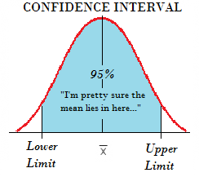

Slide 3
Confidence limits
Confidence limits are a pair of numbers used to describe an estimate or other characteristic of a population. They are the upper and lower boundaries of confidence intervals. Anywhere you calculate a confidence interval (e.g., effect sizes, non-centrality parameters, risk ratios), you will have associated confidence limits. It represents limits between which you expect to find a particular measurement or statistic.

Slide 4
More precisely, a confidence limit is a range of values, calculated around a sample statistic, that contains the true parameter with given probability α for repeated sampling. A 5% alpha level is commonly used, which is associated with a 95% confidence level. If you were to repeat your experiment over and over again, 95% of the time the true population parameter would lie between the specified lower limit and upper limit. For example, if your confidence interval for a mean (μ) is 5 < μ < 6, your confidence limits are 5 and 6. If you were to repeat this experiment, 95% of the time you would expect to find the true population parameter within these limits. There is a 5% chance that the results would not contain the true value.

